Slide 1
Video Games ≠ Violence
By Alan Rodriguez

Slide 2
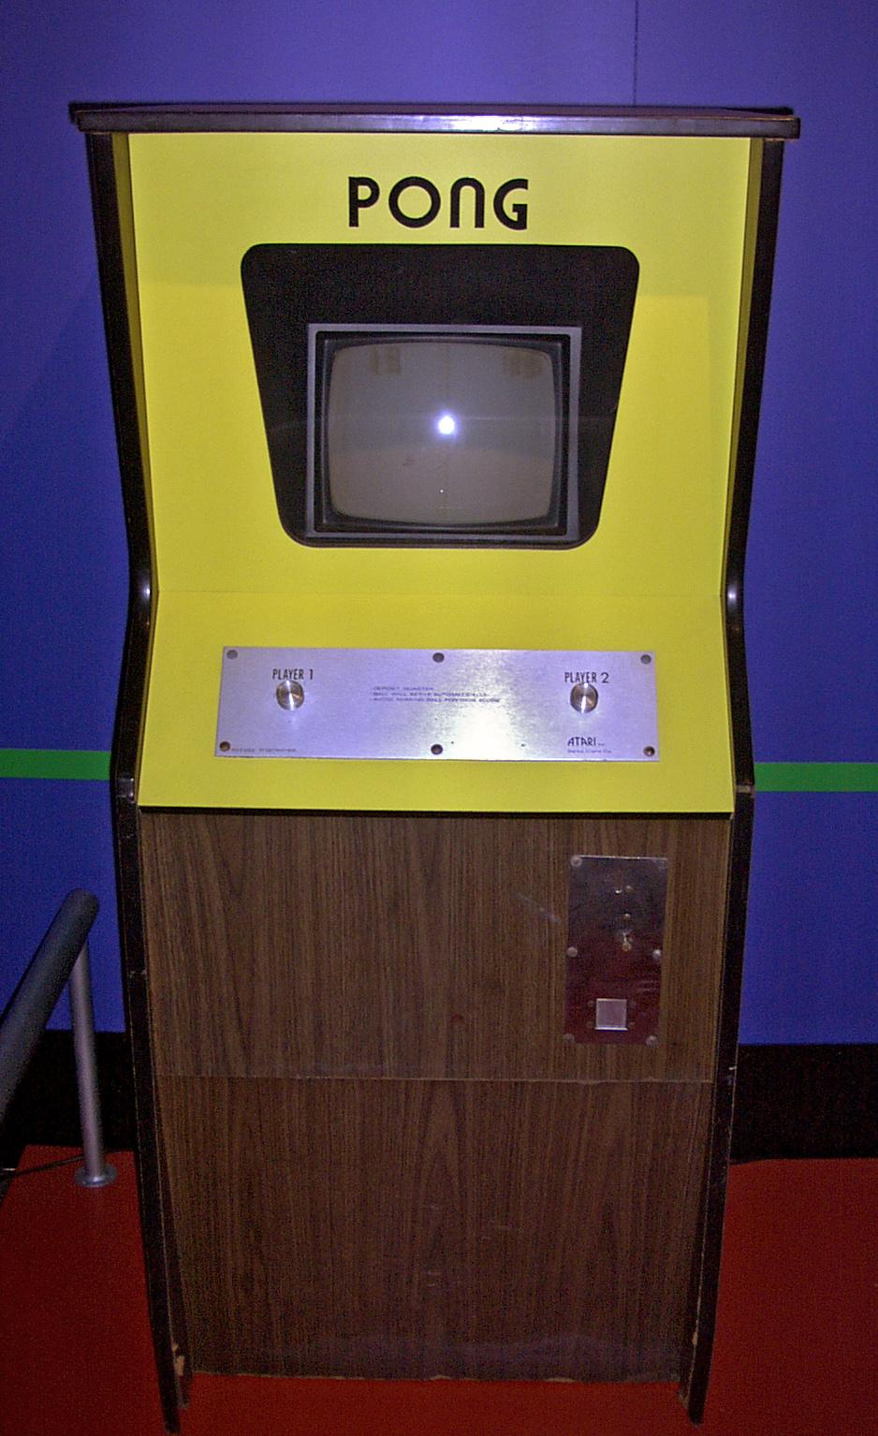
Purpose of Video Games
The first Video Game invented in 1958
This was the birth of the gaming industry an industry that made $138.7 billion in revenue
But the main reason it was made was to bring science and society together.

Slide 3
Gaming Contributes to Society
In 2019, the industry had over 300,000 employees in the US and is still growing
There have also been new forms of entertainment such as streaming
Video games also have competitive tournaments that are held a for large amounts of money

Slide 4

Why are Video Games being blamed?
A lot of people are pointing at Video Games as the cause of recent mass and school shootings
This includes U.S President Donald Trump
This is concerning because politicians do not even know what is to blame for these tragedies.

Slide 5
Do Video Games = Violence
https://www.vox.com/a/mass-shootings-america-sandy-hook-gun-violence

Slide 6

Are video games really bad?
Yes there are some video games that are intended for a more mature audience.
It has the same effect that TV had when it was new. Experts believed it was also bad for the brain.
But still nothing has showed increase in violence

Slide 7
Questions?

